Slide 1
Topic: Geometry
EQ: What are house plans and elevations?
EST content

Slide 2

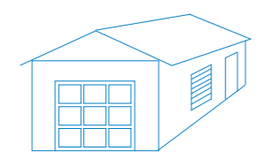

House

Slide 3
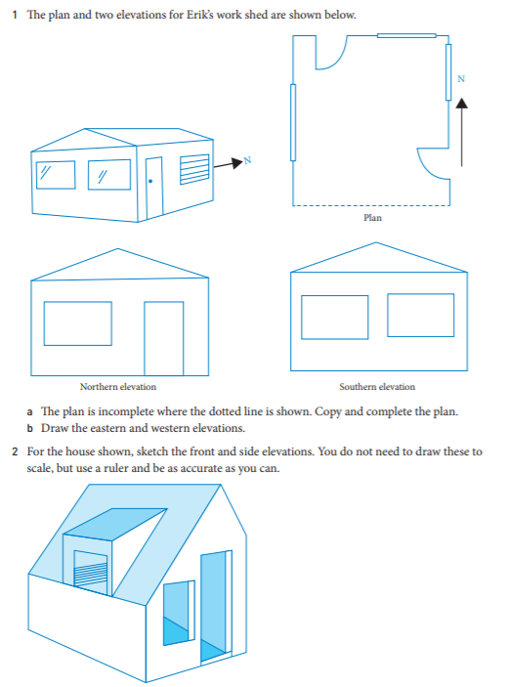
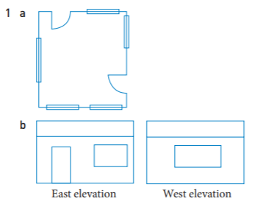
Solution

